Slide 1
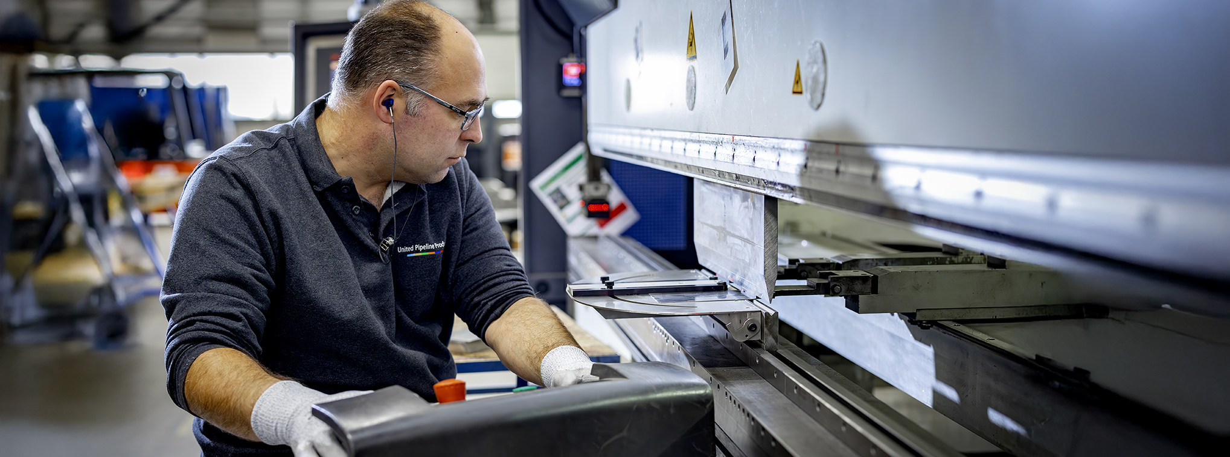
Toolbox Machine Safety: Bending machine
Company name and date

Slide 2

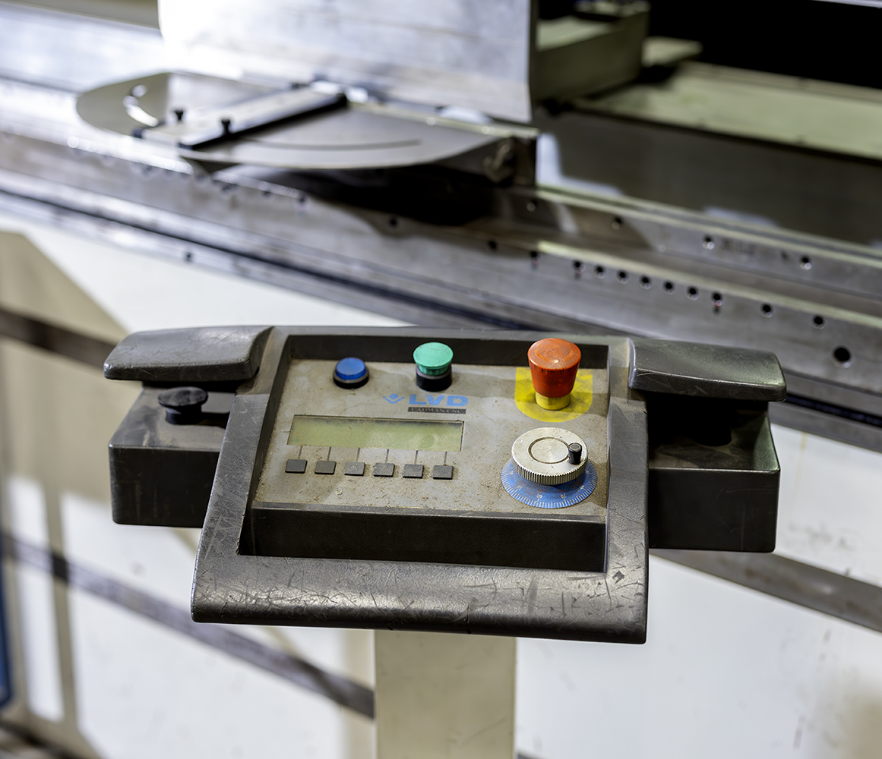
Contents
Safe and healthy working practices | Machine Safety: Bending machine
Why machine safety?
Top 3 accidents
Safe machine
What can you do yourself?

Slide 3
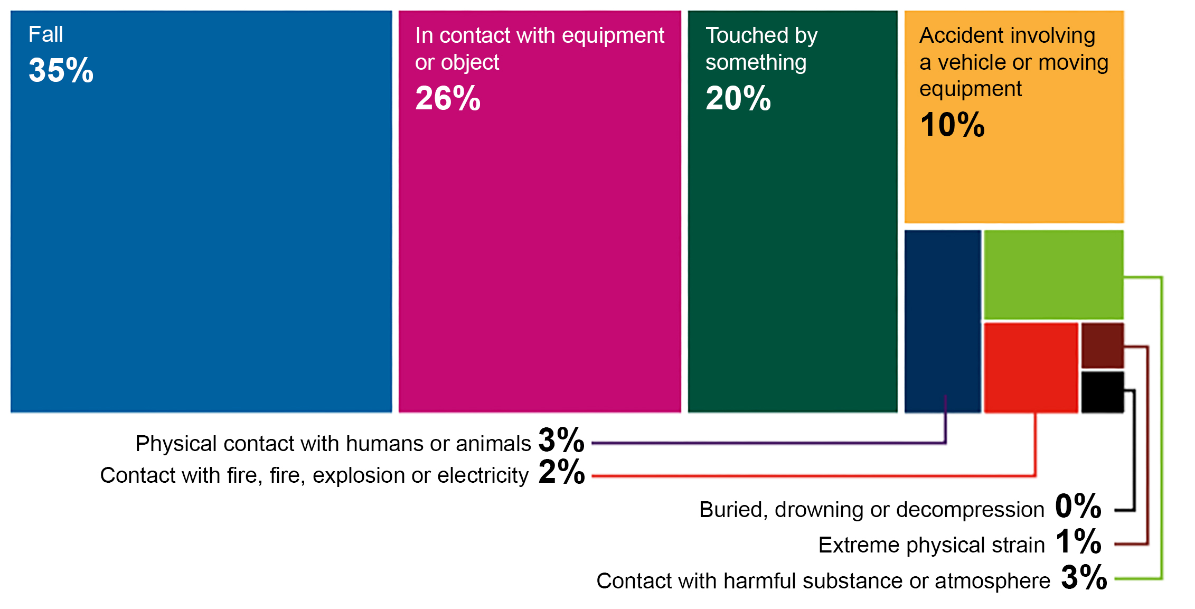
Safe and healthy working practices | Machine Safety: Bending machine
Why machine safety?
Accident investigations completed in 2023, broken down by accident type.
Large proportion of the number of reported occupational accidents.
Contact with work equipment or object 26%.
Source: Work Accident Monitor 2023 – Dutch Labour Inspectorate
Notes:
https://www.nlarbeidsinspectie.nl/publicaties/rapporten/2024/08/26/monitor-arbeidsongevallen-2023
The accident type "Contact with work equipment or object" is common in the Industrial sector (42% of accidents in that sector). The majority of accidents involve accidents in which the victim came into contact with moving parts of a machine (69%).

Slide 4
Guard missing.
Safe and healthy working practices | Machine Safety: Bending machine
Why machine safety?
Cause of contact with moving parts:
Guard missing, but insufficiently effective.
Guard removed.
Incorrect operation.

Slide 5
Foot control: hands in the danger zone.
Safe and healthy working practices | Machine Safety: Bending machine
Accidents involving bending machine: top 3
Miscommunication when two people are working on one bending machine.
Reaching in (correcting the workpiece while the bending machine is in operation).
Serious and permanent injury:
Amputation and fractures of fingers or fingertips resulting in loss of function.

Slide 6
Check whether:
Safe and healthy working practices | Machine Safety: Bending machine
Safe machine
the sides of the bending machine are shielded.
the rear of the bending machine is shielded.
the bending machine is equipped with a light curtain, laser beam protection, two-hand control with support device or other appropriate safety option - see Improvement Check of 5xBeter.
the emergency stop is readily accessible during use.
the power cables, plugs and connections are undamaged.
Notes:
The type of protection depends partly on the year of manufacture of the machine; see the 5xBeter improvement check for this.

Slide 7
Safe and healthy working practices | Machine Safety: Bending machine
What can you do yourself?
Only use the bending machine if you are authorised to do so.
Prevent clothing, jewellery and hair from getting caught.
Test the safety devices and the emergency stop.
Never bypass safety devices.
If safety devices are missing or have been bypassed, discuss this with your manager.
Be alert to the risk of entrapment between the product being bent and the bending machine (secondary entrapment hazard).
Do not start work if you have any doubts about the safety of the machine; discuss this with your manager.
When bending with several people, ensure good and clear communication!

Slide 8

Safe and healthy working practices | Machine Safety: Bending machine
Questions?
info@5xbeter.nl | www.5xbeter.nl

Slide 9
Safe and healthy working practices | Machine Safety: Bending machine
Need help?
Discuss it with your manager or contact the health and safety officer.
Consult an Improvement Coach from 5xbeter: www.5xbeter.nl
Or call the FREE Improvement Line: 0800 – 55 55 005
info@5xbeter.nl | www.5xbeter.nl

